Slide 1


Introduction to Classification
Classification is a key machine learning task. It involves predicting a categorical outcome based on input data.

Slide 2
Logistic Regression
Logistic regression is a simple and powerful algorithm. It uses a sigmoid function to map input data to a probability of belonging to a certain class.
Sample Code
Example
Imagine predicting if a customer will buy a product based on their browsing history.
from sklearn.linear_model import LogisticRegression
model = LogisticRegression()
model.fit(X_train, y_train)
predictions = model.predict(X_test)

Slide 3

Decision Tree
Decision trees are intuitive and versatile. They build a tree-like structure to make predictions based on a series of decisions.
1
Advantages
2
Disadvantages
Easy to understand and interpret.
Prone to overfitting, especially with complex datasets.

Slide 4
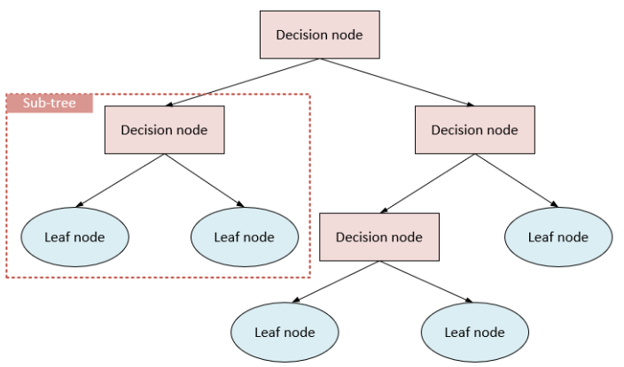

Slide 5
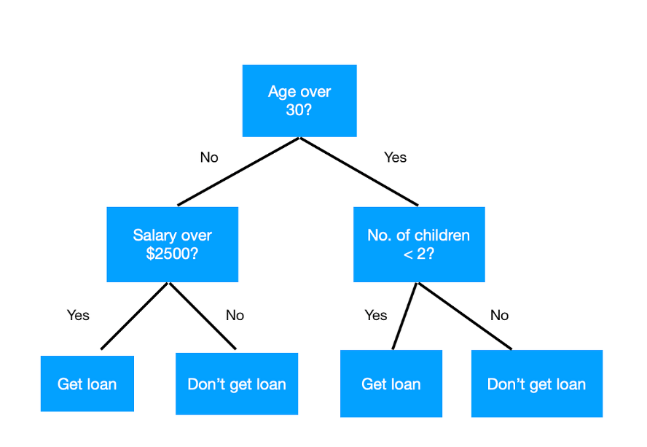

Slide 6

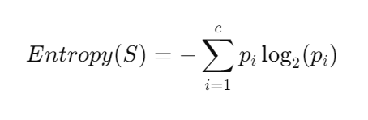
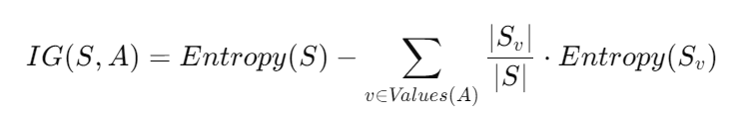
Entropy and Information Gain
Decision trees use entropy and information gain to make splits. Entropy measures the disorder in a dataset, while information gain quantifies how much splitting the dataset reduces disorder.
1
Entropy
High entropy means the data is
mixed and hard to classify.
2
Information Gain
The split that results in the highest information gain is chosen.
3
Decision
This process continues until a stopping criterion is met, building the tree.

Slide 7
Decision Tree Code
Decision tree code often involves libraries like scikit-learn. It involves fitting the model to training data and using it to make predictions.
Sample Code
Example
You might use a decision tree to predict which customer will respond to a marketing campaign.
from sklearn.tree import DecisionTreeClassifier
model = DecisionTreeClassifier()
model.fit(X_train, y_train)
predictions = model.predict(X_test)

Slide 8

Overfitting
Overfitting occurs when a model performs well on training data but fails to generalize to new data. It's like memorizing the answers instead of understanding the concepts.
Causes
Consequences
Complex model, insufficient data.
Poor performance on new data, unreliable predictions.
Solutions
Pruning, regularization, cross-validation.

Slide 9

Underfitting
Underfitting happens when a model fails to learn the patterns in the data. It's like not paying attention to the material.
Causes
Consequences
Simple model, insufficient features.
Poor performance on both training and new data, inaccurate predictions.
Solutions
Adding more features, increasing model complexity.

Slide 10
Model Evaluation Metrics
Model evaluation metrics help measure how well a model performs. They are used to assess the model's accuracy, precision, and other important factors.
Regression
Classification
Mean Squared Error (MSE)
Accuracy
R-squared (R2)
Precision
Recall
F1-score

Slide 11

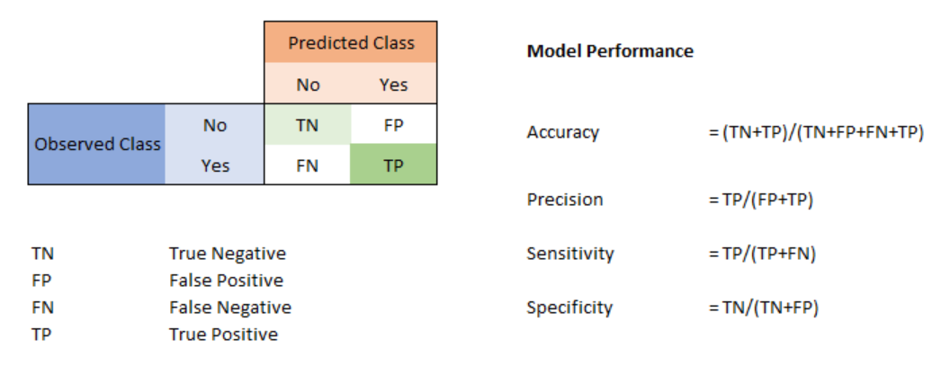
Confusion Matrix
A confusion matrix is a matrix that summarizes the performance of a machine learning model on a set of test data.

